Slide 1
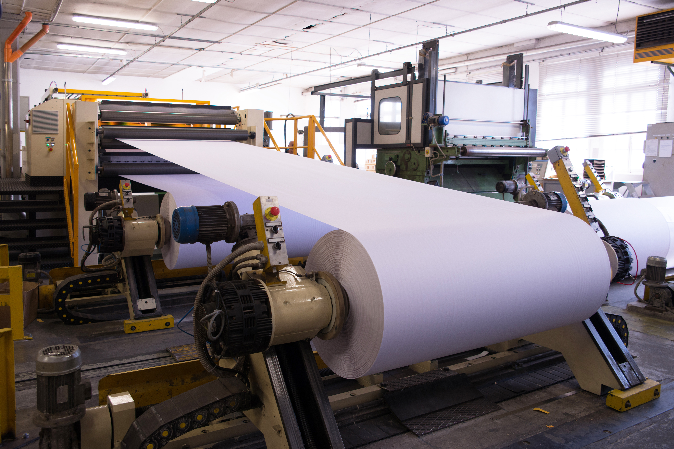
East Canada Paper
Technical Solution Design

Slide 2
High-level functional requirements
An app for managing buying events with suppliers to reduce the total time taken for individual events and for supplier optimization
A mobile customer engagement app that enables customers to order products online. Include customization options based on the customer’s preferences for both cost and environmental impact
Analyze sales data to understand the trends across sales offices, customers, and products.
Analyze operational data to streamline operations. For example, stocking the right items in the right areas and from the right suppliers for quick turnaround, reducing cost, and improving quality.
Predict failure or malfunctioning of mill equipment and thus downtime due to factors such as poor maintenance schedules.
Optimize the use of resources to reduce waste and meet sustainability goals.

Slide 3
Solution approach(1/3)
 | Requirement | Solution
1 | An app for managing buying events with suppliers to reduce the total time taken for individual events and supplier optimization | SAP Fiori app through which ECP employees can buy from suppliers. Features should include: Option to choose a supplier based on comparative evaluation Standard pre-filled templates for frequent transactions Option to select various combinations of supplier, wood, equipment etc. for customized orders.
2 | A mobile customer engagement app that enables customers to order products online. Include customization options based on the customer’s preferences for both cost and environmental impact. | SAP Fiori mobile app for customer engagement with features such as: System recommendations based on customer choices/priorities Option to view photos/videos/textual information of products, expected delivery date, etc. Display cost discount options (based on membership, season, bulk purchase, etc.) A section focused on the environmental impact of customer choices

Slide 4
Solution approach(2/3)
 | Requirement | Solution
3 | Analyze sales data to understand the trends across sales offices, customers, and products. | Utilize SAP Analytics Cloud (SAC) to provide solutions for: Sales trends across offices, customers, products, and regions Prospect to customer conversion rates Pipeline trends
4 | Analyze operational data to streamline operations. For example, stocking the right items in the right areas and from the right suppliers for quick turnaround, reducing cost, and improving quality. | Utilize SAP Analytics Cloud (SAC) to provide reports associated with: Speed of fulfillment Feedback on products and services delivered Rework index Preventive maintenance of equipment

Slide 5
Solution approach(3/3)
 | Requirement | Solution
5 | Predict failure or malfunctioning of mill equipment and thus downtime due to factors such as poor maintenance schedules. | Utilize SAP Analytics Cloud to predict: Equipment downtime
6 | Optimize the use of resources to reduce waste and meet sustainability goals. | Utilize SAP Analytics Cloud to create reports on: Water and fuel consumption Waste generation and re-use Sales pattern vs inventory levels

Slide 6
Design considerations from Design Thinking Exploration
Empathize – Define – Ideate – Prototype – Test
Name of the app: Customer Engagement
Users of the app are mostly from purchase departments of businesses
They constantly interact with multiple vendor apps/sites. The app should align with industry-standard features for consistency, and have additional functionality for differentiating the brand from the competition
Users are from varied industries such as Commercial printing, retail, food services, etc. The expectations are quite different. Provide an option to choose an industry to make the experience personalized for the industry.
Most of the users are repeat customers. Provide an option to view their previous orders to reduce the time taken by a user to submit an order.

Slide 7



Solution diagram
Mobile apps
Analytical apps
SAP BTP
SAP Fiori
SAP Analytics Cloud
SAP S/4 HANA Cloud
S&D
SCM
MM
PM
Finance
Warehouse Management
Other data sources

Slide 8
Considerations/Assumptions
Operational data analytics would need input from non-SAP systems such as Warehouse Management system. Need to ensure integration with legacy systems for up-to-date data synchronization.
IoT devices should be implemented on equipment to receive operational data as input for analytics
SAP Analytics Cloud (SAC) to be part of the SAP BTP implementation

Slide 9
To-do before Realize phase
Build the final to-do list and the final validation list for Q-Gate, and prepare signoff for the next phase.
Ensure that the existing landscape incorporates any required add-ons (extensions) or third-party software.
Estimate efforts, sequence of activities to perform in the Realize phase, and ensure staff allocation, and facility availability.

Slide 10
Product backlog
For the app to buy from suppliers and the Customer Engagement app:
Build app
Create development documentation
Create configuration documentation
Write test scripts
Create end-user documentation
For analytical tools
Build functionality
Create development documentation
Create configuration documentation
Write test scripts
Create end-user documentation

Slide 11
Thank you!

